Slide 1
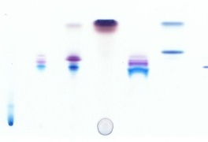
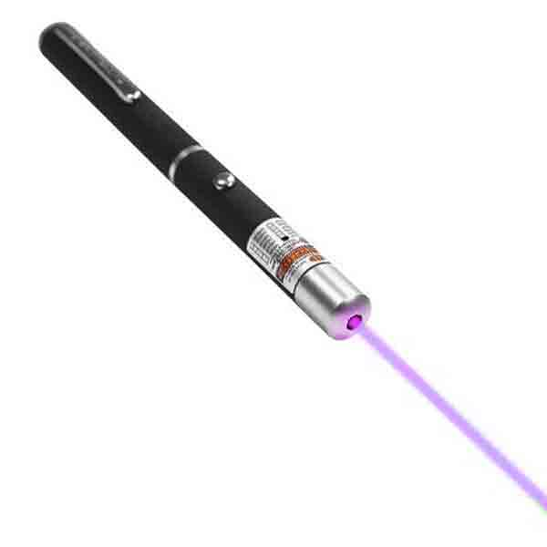
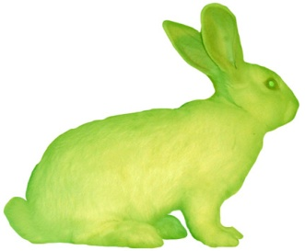
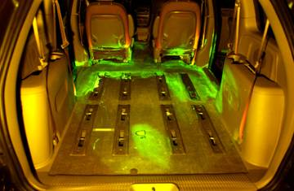
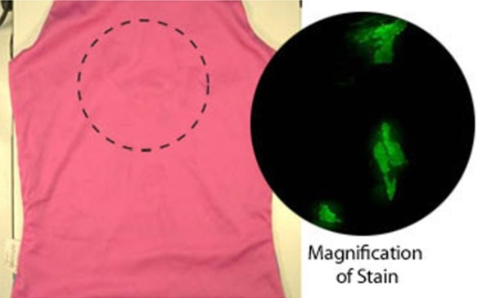
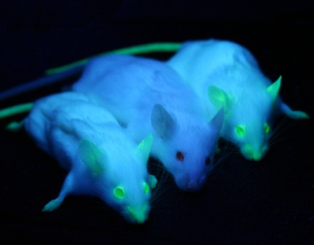
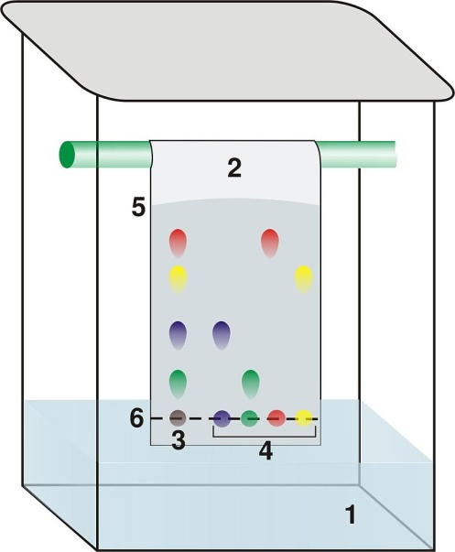
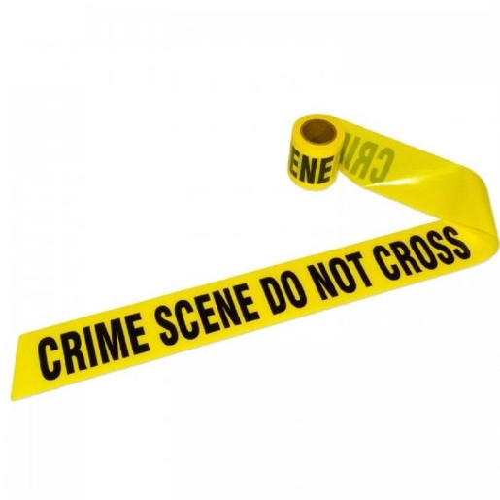
Lab 9: Forensic Techniques
Forensic Analysis: Forensic tests are done for the purpose of presenting results in a court of law or for use in public debate. However, the techniques that forensic scientists use can be useful for many kinds of evidence gathering at work, home, or in the field. In other words, we often encounter the need to understand what’s going on so that something can be fixed or a mystery can be solved. For example, when something goes wrong our car, we are like detectives trying to figure out what it is. Forensic techniques can be useful for that. Our eyes are good for looking for evidence but some things are not always visible. That’s where scientific tools are used to help us see more. A common tool used in forensics investigation is an ultraviolet flashlight or UV laser. These can make substances that are normally invisible glow (fluoresce) so that they can easily be seen.
Fluorescence: Making things glow aids in investigation. Biologists have inserted genes that make jellyfish glow into other animals. That makes other animals glow in certain areas or all over. Also, forensic investigators use a dye called fluorescein to cause traces of blood to glow. Fluorescein placed in water can track leaks and water pollution.
Genetically modified to glow
Invisible blood stains glow due to treatment with fluorescein
Thin Layer Chromatography (TLC): In forensics, identification of certain drugs or comparison of inks and other substances are often done with thin layer chromatography. The setup for TLC is relatively simple. It involves placing samples on paper (or other thin layer material) and allowing solvent such as water/alcohol mixture to climb up the paper. As it does, the components in the sample will travel at different speeds. This causes them to separate. So samples that initially look the same will be shown to be different if they produce spots of different colors or spots at different heights. Thin layer chromatography works best with colored samples (hence the name “chroma”); however, UV light can make some non-visible components of the sample glow and be visible.
Notes:
Crystallization is used to purify a solid. The process requires a suitable solvent. A suitable solvent is one which readily dissolves the solid (solute) when the solvent is hot but not when it is cold. The best solvents exhibit a large difference in solubility over a reasonable range of temperatures. (eg, Water can be a crystallization solvent between 0-100oC; hydrocarbon solvents such as hexanes or petroleum ether have a different T range since they can be cooled below 0 degrees but boil below 100 degrees). Characteristics of a solvent: a. chosen for solubilizing power-- solubility usually increases with increasing T b. polarity is important--like dissolves like; polar compounds are more soluble in polar solvents; nonpolar compounds in nonpolar solvents c. should be INERT but few are; eg, acetic acid is sometimes used as a solvent although it will certainly react with basic compounds d. almost all solvents are COMBUSTABLE--avoid flames e. mixed solvents (eg; 1:1 water/methanol) provide a huge range of possible solvents but they must be soluble in one another Q: Is 95% ethanol a mixed solvent? Use solvent to get solids into solution but to get them out of solution: a. lower the temperature--solute will be less soluble b. concentrate the solution by removing solvent with a hot plate,

Slide 2
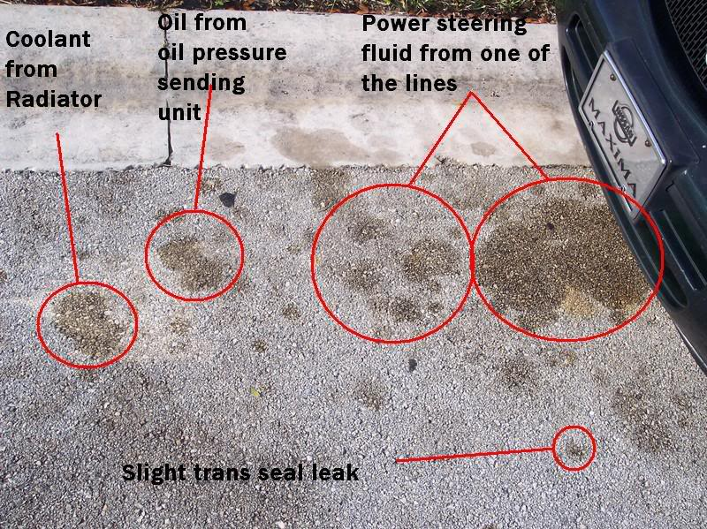
Lab 9: Forensic Techniques: Chromatography & UV
Connecting suspect to crime using Thin Layer Chromatography : In some crime investigations, the question of who did some writing is key (like who wrote a check or who wrote a ransom note). The strategy is to see if the pen that did the writing is the same pen that a suspect is carrying. This can be done by seeing if the inks match. TLC is a visual way to do that.
1) Cut a sheet of paper to 9” by 5”. Draw a line using a pencil 1.5 inches (3.8 cm) from the bottom of the sheet. Starting at 2.5 inches from the left, place dots using a pencil at every half inch along that line. Label them “unk and 1, 2, 3, 4, 5, 6, 7, 8, & 9.
2) On the “unk” (unknown) dot, carefully place a dot of ink from a
9” x 5” sheet
1.5”
. . . . . . . . . .
unk 1 2 3 4 5 6 7 8 9
2.5”
bottle that contains ink that was extracted from the written evidence (ransom note, check, etc.). You will either use a small pipette or a small syringe to do that. The instructor will provide extra explanations on how to do it. 3) You will then use the 9 pens to place a 1 to 2 millimeter dot of ink over the remaining 9 pencil dots.
4) Roll the sheet of paper into a cylinder and use a stapler to connect the two ends of the paper.
5) Get a chromatography jar and place ¾” (19 mm) of solvent into the jar. The solvent is usually a mixture of rubbing alcohol and water, acetone or water, or some other solvent. Different groups may be given different solvents.
6) Carefully place the sheet of paper (coiled into a cylinder) into the jar with the solvent. Replace the cap.
7) Work on the other parts of this lab while the solvent is climbing up the paper. Wait until the solvent has risen at least half way up the paper before making a conclusion.
At the end of this experiment, the class can compare their chromatographs to see which mixture did the best job in separating the components of the inks.
8) Decide which pen best matches the pen used in the crime, or say no pen was a match. Also, results can be inconclusive if the chromatography did not produce a good separation or distinction between the spots. Let instructor see your results. Matches Pen #: ______ No Match Inconclusive
Automotive Fluids: Finding & identifying fluids leaking from a car is a good skill. A UV flashlight can help with that. In the photo these stains look alike, but under UV light, they can look very different, which is helpful in identifying & spotting what is leaking.

Slide 3
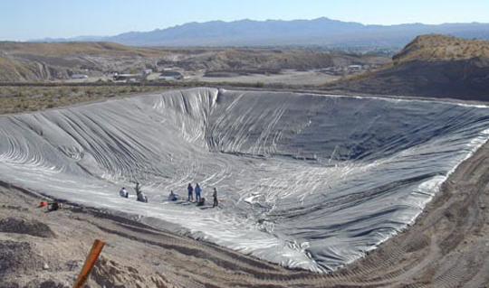
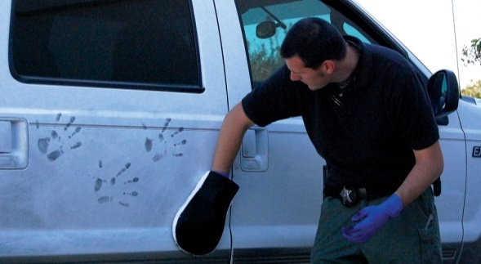
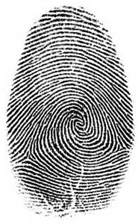
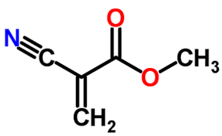
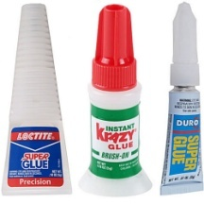
Lab 9: Forensic Techniques: Fluorescein & Latent prints
Detection of Holding Pond Leaks: Holding ponds are reservoirs that store polluted run-off water such as waste water from mines or from animal waste on cattle, chicken, and pig farms. The holding ponds are supposed to be sealed so that polluted water cannot leak out into the environment. Sometimes the leak is obvious but other times it is hidden. Fluorescein can be used to detect the hidden leaks.
You will use a Ziploc bag to represent a lined holding tank. A Ziploc bag (like a good holding pond) supposedly keeps its contents sealed in the bag. You will check to see if your Ziploc bag truly does that.
Place 100 mL of water into a sandwich size Ziploc bag.
Add 6 drops of the concentrated Fluorescein solution then seal the bag.
Check outside of the bag with an UV light to make sure no Fluorescein is on the outside of the bag.
Measure out about 250 mL of distilled water (or tap water). Add the water to the larger Ziploc bag. Place the small Ziploc bag with the Fluorescein into the large (quart size) Ziploc bag.
Gently rock the large Ziploc bag back and forth for about a minute, then let it sit for about another 10 minutes.
Remove the small inner Ziploc bag from the larger Ziploc bag.
Shoot the purple laser through the larger bag to see if the beam is green. If so, the inner Ziploc bag leaked.
Latent (present but not visible) fingerprints: The chemical composition of our fingerprints allows various methods to be used to make them visible. 1) oils in our fingerprints are sticky. So powders such as small iron filings will stick to them making them visible. 2) There is also salt (sodium chloride) in fingerprints. Silver ions in a solution of silver nitrate will latch onto the chloride ions
in the fingerprint producing white particles (silver chloride). Then in sunlight or UV light, the silver ions become metallic silver particles, which are black. 3) Fingerprints also contain proteins. A chemical called “Ninhydrin” reacts with NH₂ groups on the proteins, which turns Ninhydrin from white to purple. So when sprayed with a dissolved solution of Ninhydrin, the fingerprints become visible as purple prints. 4) Glues such as “Super Glue” and “Krazy Glue” contain forms of cyanoacrylate. You may have experienced your fingers getting glued together when using Super Glue. Super Glue also sticks to fingerprints because of small amounts of water being present.
Fingerprint technicians place items into a closed container containing cyanoacrylate. When heated, the cyanoacrylate turns to vapors which find their way to the latent fingerprints. The cyanoacrylate reacts with the moisture in the prints to form a white polymer which makes the prints visible. 5) Crystals of iodine are warmed so that they turn to vapor. This is blown across the latent fingerprints. Oils and fats in the prints absorb the iodine vapor and turn black.
The lab will be set up so that you can use one or more of the above methods to “dust” for prints. Show your instructor that you completed one or more of these methods.
Cyanoacrylate
Items to take home: UV flashlight. You will be looking under the hood of your car to see if any liquids fluoresce. Also, you can look around your house to find stains or residues from cleaning products. See online manual.

